Slide 1
Tracking II: Visual human motion tracking
D E P A R T M E N T O F C O M P U T E R S C I E N C E U N I V E R S I T Y O F C O P E N H A G E N
Kim Steenstrup Pedersen

Slide 2
Plan for today
Visual human motion tracking:
Marker-based versus marker-less tracking
Articulated visual 3D tracking
Work on assignment 4

Slide 3
3D human motion tracking
Def.: Estimation of 3D pose and motion of an articulated model of the human body from visual data – this is referred to as motion capture.
Marker-based motion capture (MoCap):
Outcome: Tracking markers on joints in 3D giving joint positions.
Markers: Acoustic, inertial, LED, magnetic, reflective, etc.
Cameras or active sensors.
Marker-less motion capture (MoCap):
Outcome: 3D joint positions or triangulated surfaces and relation to video sequence.
Multi-view (several cameras / views)
Monocular (single camera / view)
Camera / view types: Optical camera, stereo pair, time-of-flight cameras, etc.
Notes:
Also known as “motion capture”
Marker-based used by Hollywood.
Today I will focus only on 3D marker-less visual tracking.

Slide 4
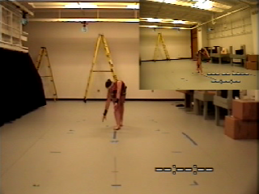
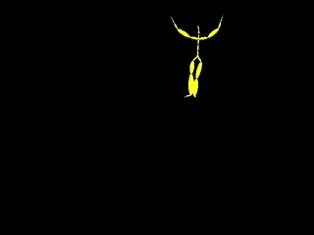
3D Marker based motion capture
[http://mocap.cs.cmu.edu/]
Notes:
Notice that she wears markers strategically placed on her body.
The two videos are not synchronized.

Slide 5
System from Vicon (www.vicon.com)
http://www.youtube.com/watch?v=2uDnW4AtFiE&feature=player_embedded

Slide 6
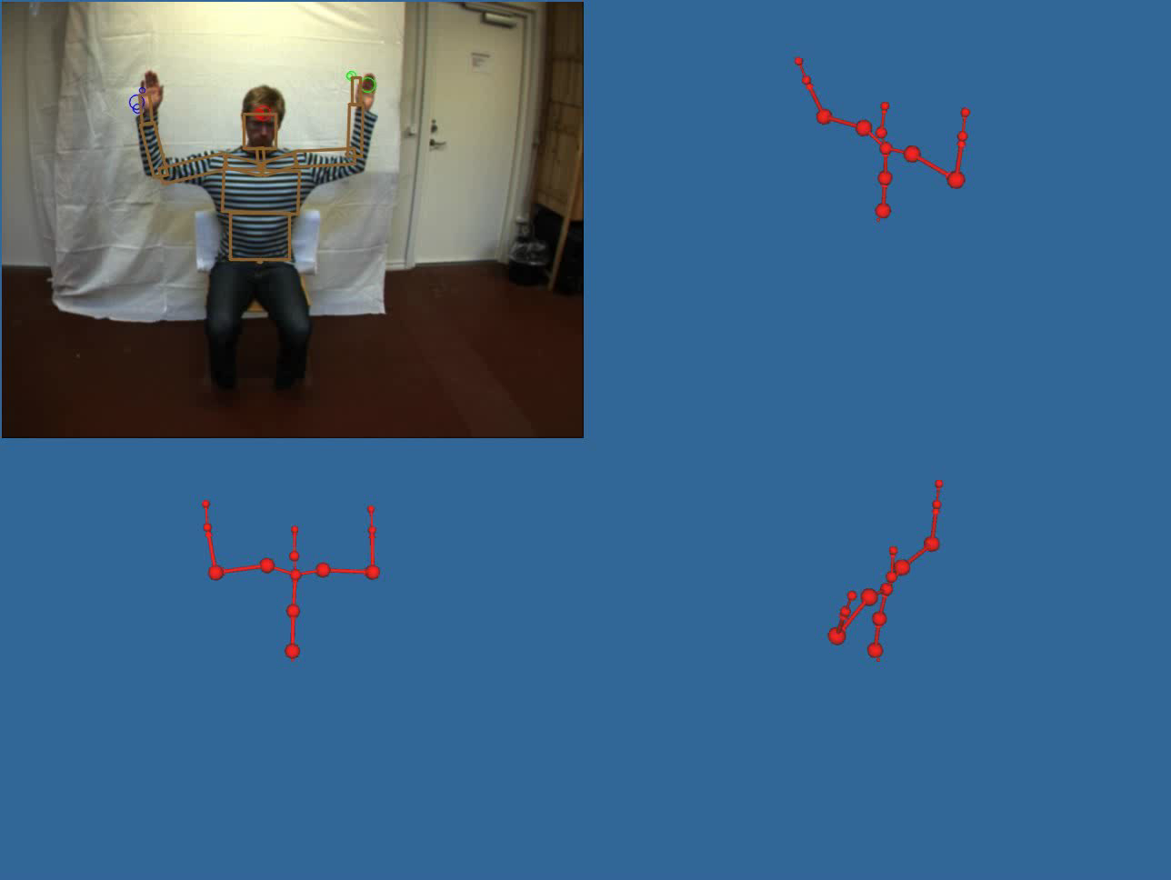
3D Marker-less motion capture (Upper body) (Using a single optical camera)
[Hauberg et al, 2009]
Notes:
We want to estimate joint positions or joint angle configuration from video without markers.

Slide 7
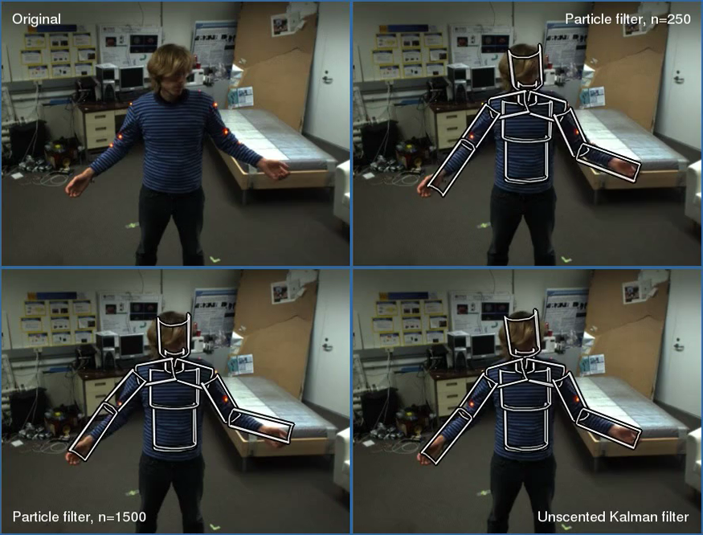
Another example: Using a stereo camera (Markers for ground truth)

Slide 8
Why do we want to do tracking of human motion?
Human computer interaction: Non-invasive interface technology
Computer animation: Entertainment (movies and games), education, visualization

Slide 9
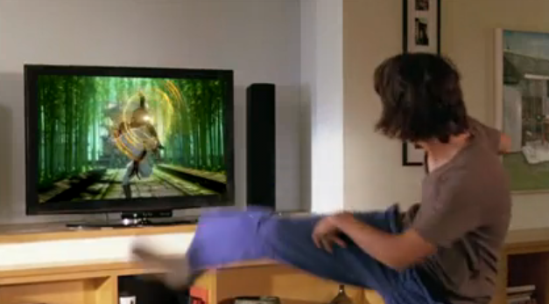
Computer games: Microsoft Kinect interaction technology
http://www.youtube.com/watch?v=g_txF7iETX0
Notes:
The MS kinect is an active stereo camera.

Slide 10
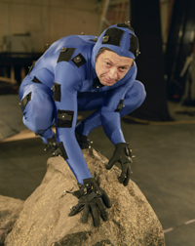
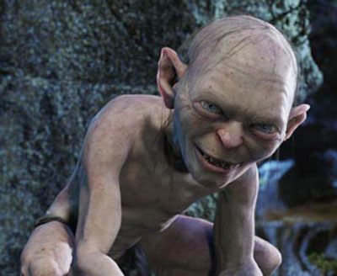
Computer animation: Transfer motion from actor to CG character

Slide 11
Why do we want to do human motion analysis?
Human computer interaction: Non-invasive interface technology
Computer animation: Entertainment (movies and games), education, visualization
Surveillance: Suspicious behavior recognition, movement patterns
Biomechanical modeling
Physiotherapeutic analysis: Sports performance enhancement, patient treatment enhancement
Notes:
Biomechanical modeling: As a measurement tool. Collect empirical evidence useful in improving human motion models.

Slide 12
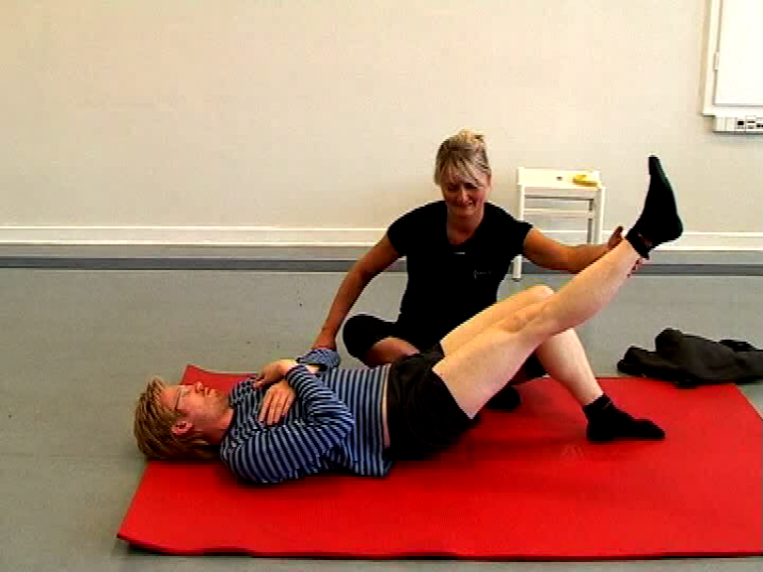
Interactive physiotherapy: Interactive training with feedback at home

Slide 13
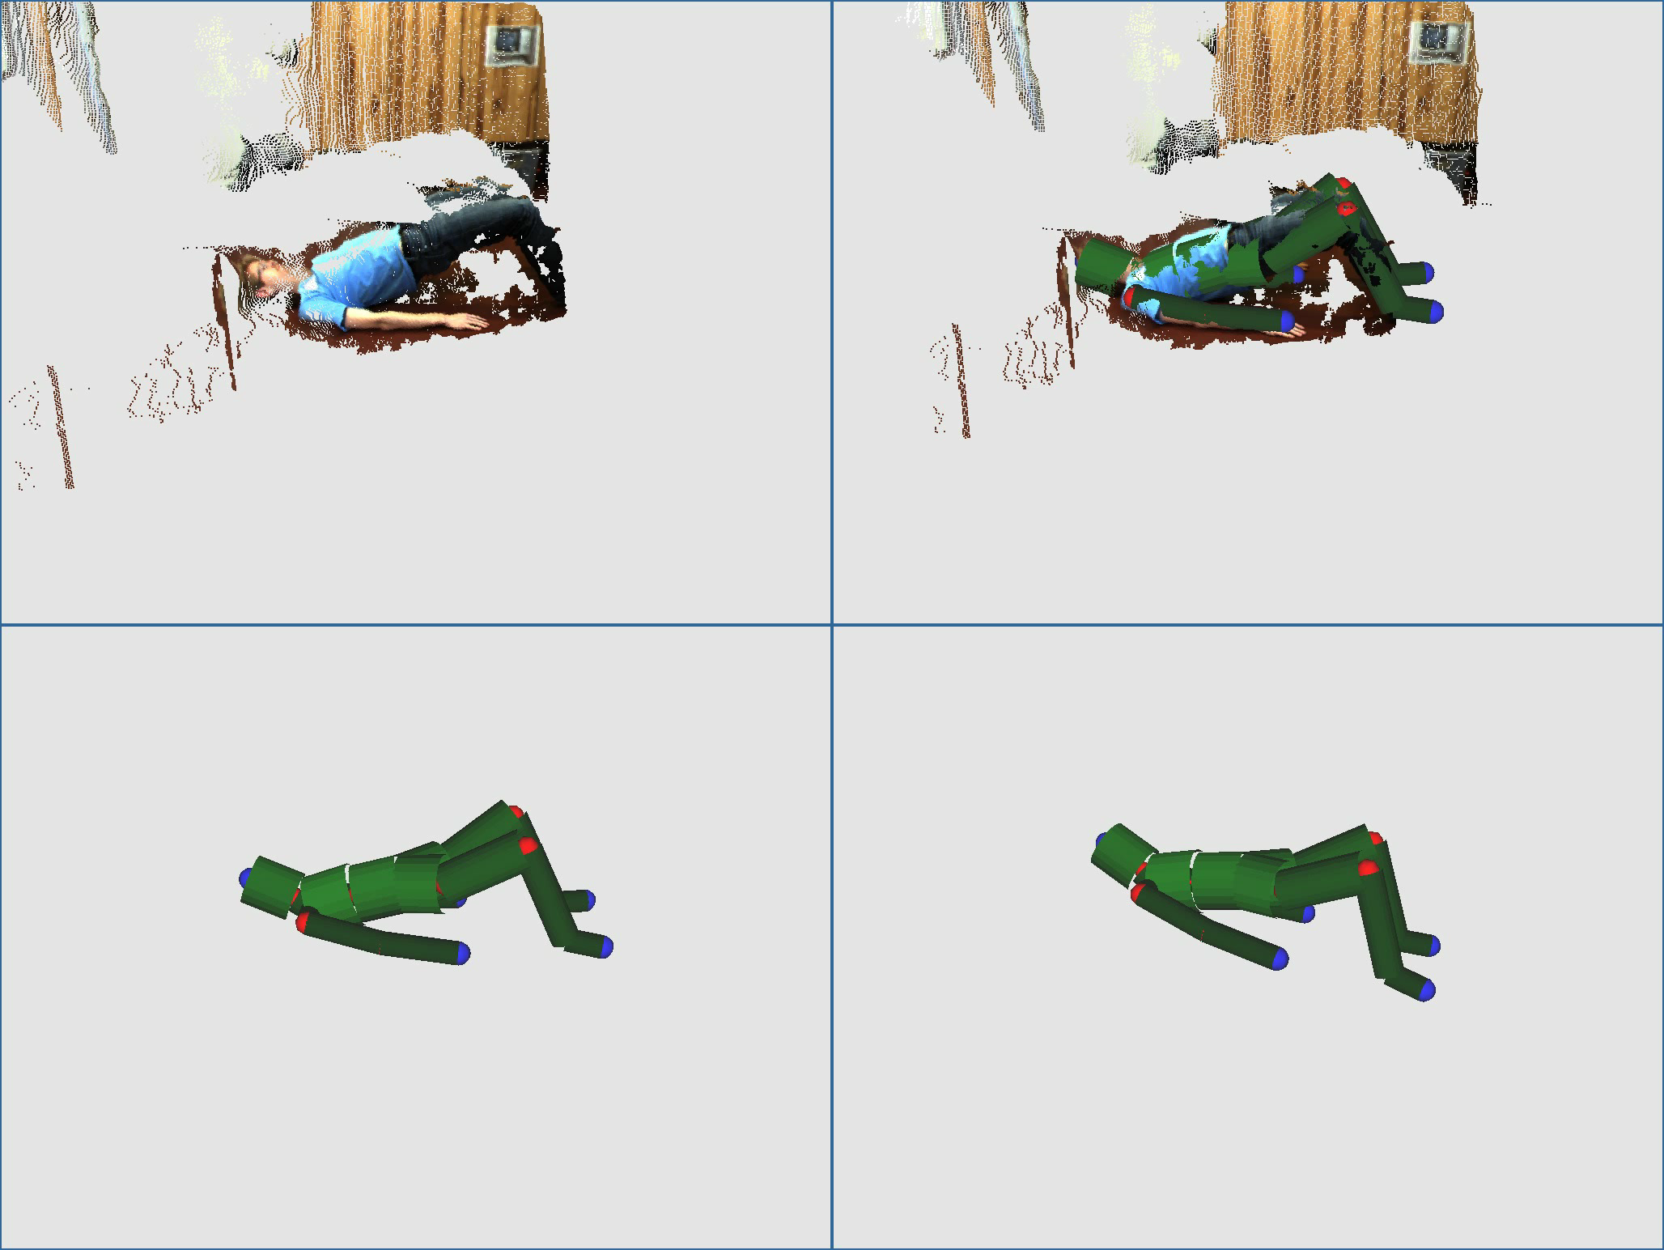
Interactive physiotherapy: Measurements

Slide 14
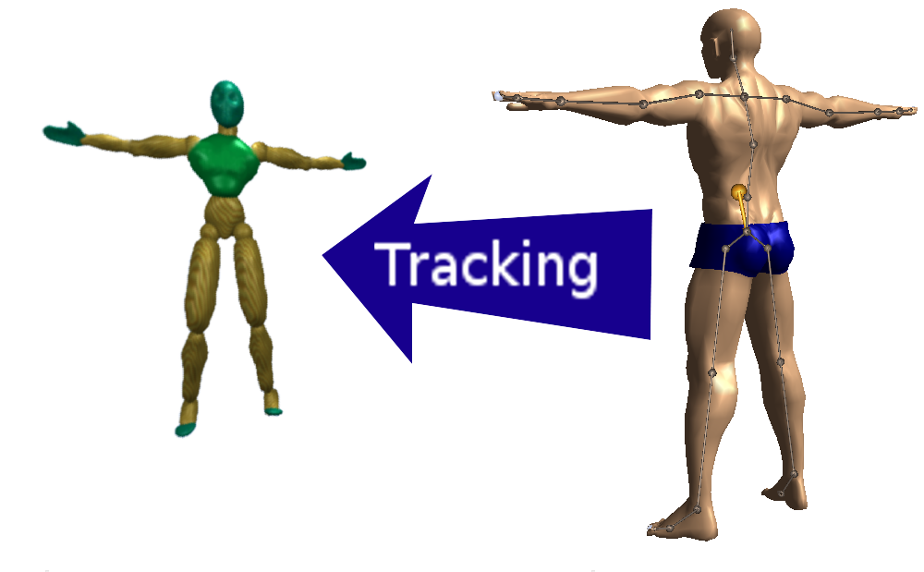
Vision for interactive physiotherapy: Measurements

Slide 15
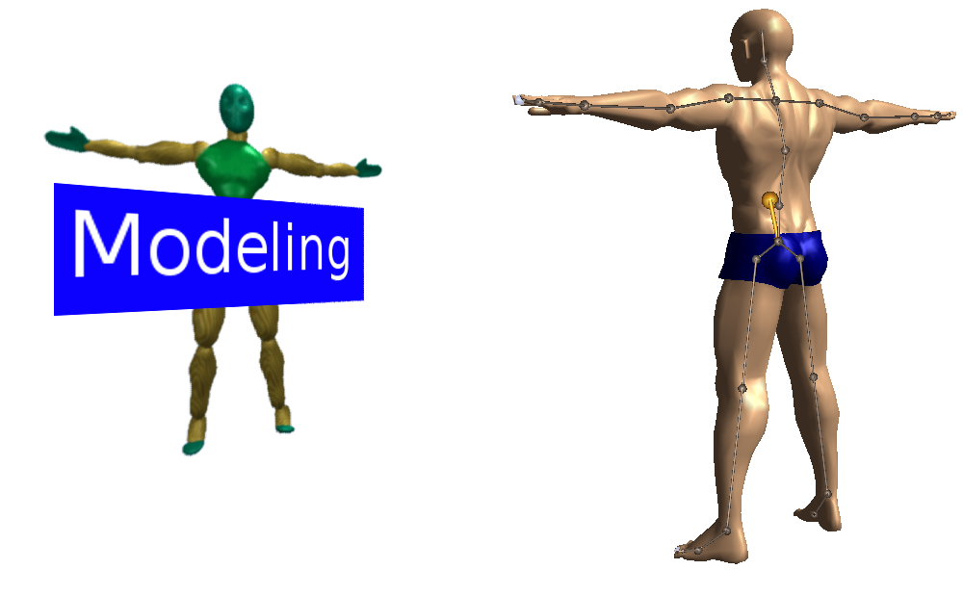
Vision for interactive physiotherapy: Modeling of exercise

Slide 16
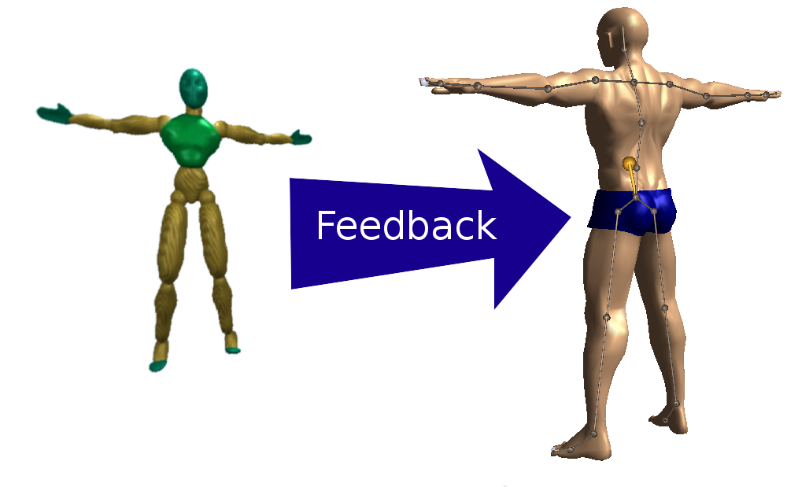
Vision for interactive physiotherapy: Feedback (“lift your arms higher”)

Slide 17
Demo

Slide 18
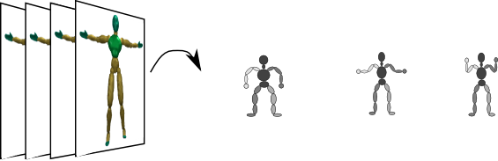
This is what we want to do (Tracking = seq. estimation of pose from observations)
Video sequence
Sequence of estimated poses
Notes:
The video sequences can be from one or more cameras / views

Slide 19
Approaches to visual marker-less tracking
Model-based tracking
Introduce a model of the human body and estimate pose by estimating model parameters from observations.
Downsides: Relation between model and observation is important. Often these methods require re-initialization.
Model-free tracking
Learning-based approach: Learn a direct map from observations to pose (e.g. a classifier)
Examplar-based approach: Infer pose by matching observations to examplar poses.
Downsides: Requires lots of training examples to either learn or construct examplar database.
Notes:
I will mainly talk about model-based approaches today

Slide 20
Observations
Types of observations:
Texture / regions measure
Features
Silhouette
3D reconstruction / depth data (stereo, time-of-flight, active stereo (e.g. MS Kinect)).

Slide 21
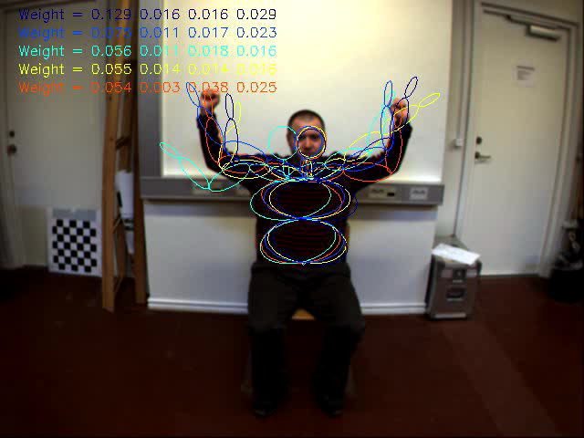
Observations: Region-based texture descriptors
Notes:
Quite simply histograms of gradient orientations

Slide 22
Observations: Silhouettes
Elgammal & Lee: T-PAMI, 2009

Slide 23
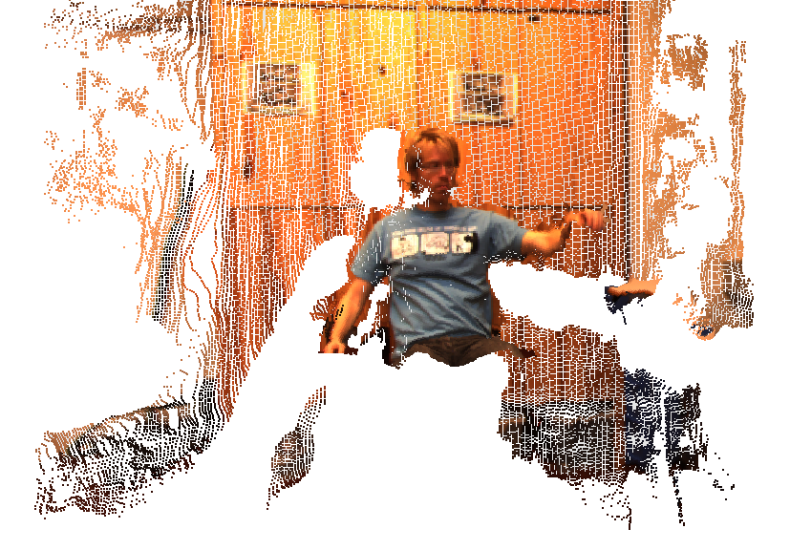
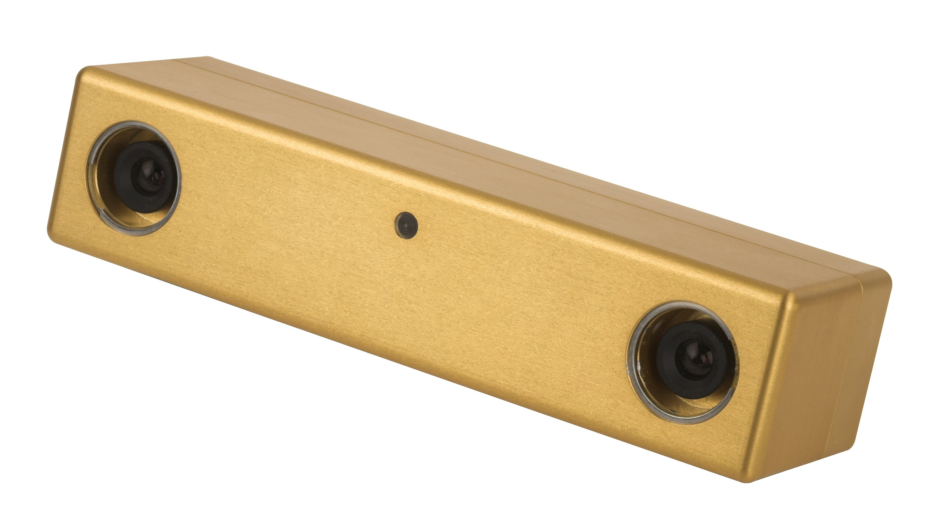
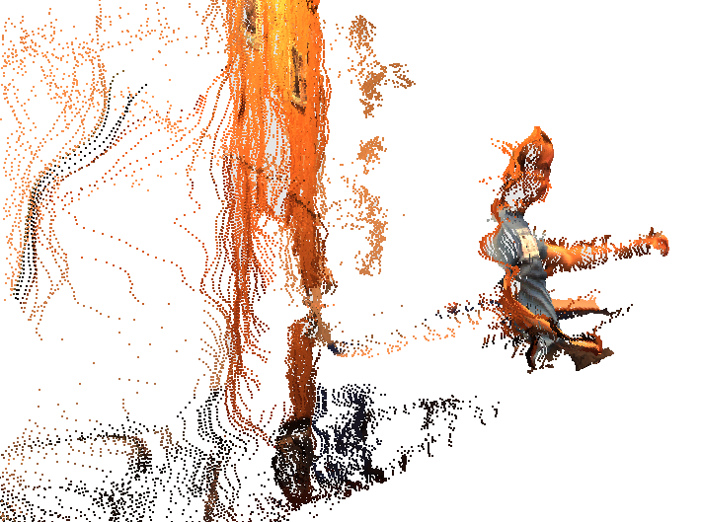
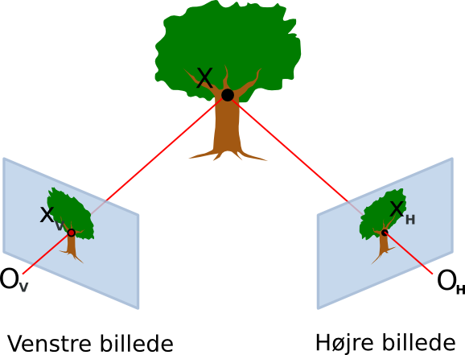
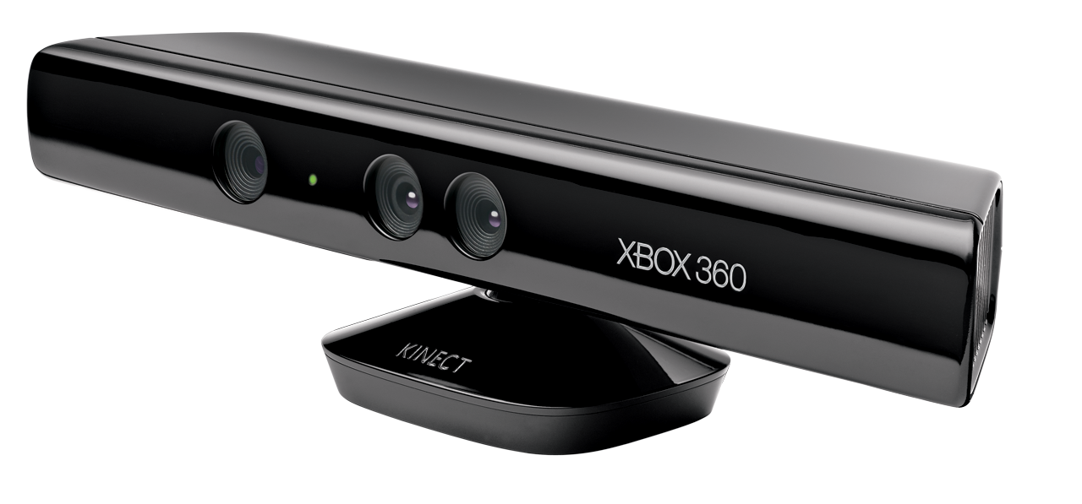
Using dense stereo as visual observations
Stereo camera leads to dense depth maps and 3D point clouds.
We use a Point Grey Bumblebee2 stereo camera
MS Kinect sensor
Notes:
From these visual observations we would like to infer the 3D pose of the subject in the video sequence.

Slide 24
Show live depth map

Slide 25
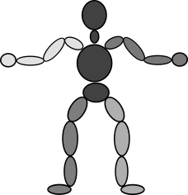
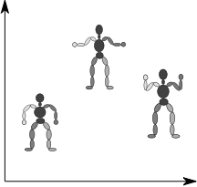
Human body model (The model-based approach)
The human body is commonly modeled as an articulated collection of rigid limbs connected with joints.
Common representation:
Vector of joint angles together with some representation of global position and orientation.
Geometric shapes for modeling limb surface (boxes, ellipsoids).
Other representations:
Joint positions
End-effector positions
Pure surface models
…
[Hauberg et al, 2009]
Notes:
Joints have different degrees of freedom: Elbow joint has 1 dof, shoulder has 2 dof, etc. Normal full body degrees of freedom D is approx. 30 – 80.
Geometric shapes are used in observation model, and is not really important for us today.
Other representations are possible, but this will do today.
Explain what is meant by end-effector: E.g. Hands, feeds, head.

Slide 26
Modeling the skin surface
Common surface models:
Boxes
Cylinders
Quadrics
Polygonal mesh skin models

Slide 27
Examples of surface models
Poppe: CVIU, 2007

Slide 28
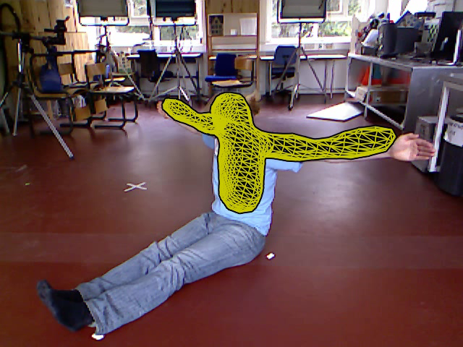
A polygonal mesh skin model in action

Slide 29
Human body model constraints
Natural physical constraints:
Body limitations, e.g. joint angle limits, limb dimensions (volume, length, etc.), …
Non-penetrability of limbs
Angular velocity and acceleration limits
Constraints can be modeled as either hard or soft constraints.
Notes:
Bent your elbow too much and it will break!
We are not able to move at the speed of light, so we might want to put some limits on angular velocity and acceleration.

Slide 30
This is what we want to do (Tracking = seq. estimation of model from observations)
Video sequence
Sequence of estimated poses
Notes:
Recap

Slide 31
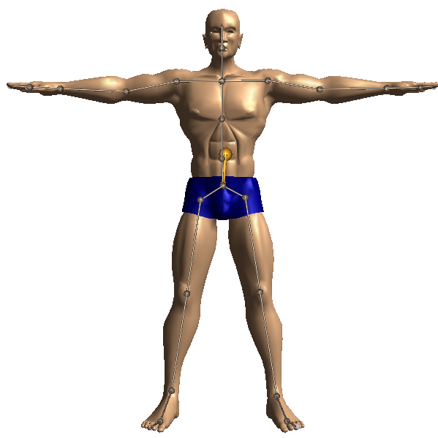
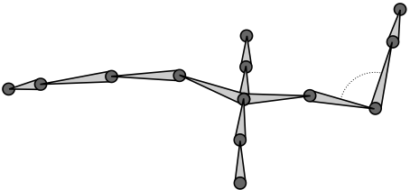
Visual human motion modeling and tracking (Tracking = seq. estimation of model from observations)
Model: Stick figure representation of human body (rigid sticks connected by joints, no mass).
Model parameters a.k.a. the state: Vector of joint angles
Observations: Video sequence of motion
Notes:
E.g. D=50

Slide 32
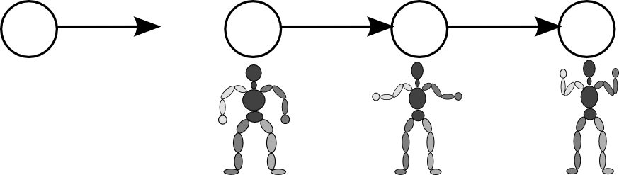
How do we include dynamics into our model?
Lets assume that the current state only depends on the immediate past state. We assume that somehow we can compute the new state given the old state!
However, this update of states is stochastic (uncertain) – we are going to estimate it from noisy observations.
Notes:
At every time instance our model is in some state / configuration
Or rather we want to include uncertainty so we model the probability of being in a certain configuration
Uncertainty e.g. due to ambiguities.

Slide 33
Enter probabilistic graphical models
This is an example of a simple graphical model:
First order Markov chain
A directed acyclic graph (DAG) or tree, if you will.
Def. Graphical model: Graph based model where nodes represent random quantities / variables and edges represents dependencies among variables.

Slide 34
Enter probabilistic graphical models
If we know the transition conditional probability distributions and the prior distribution on the initial state, we can compute the probability distribution of state sequences (of particular sequences of stick figures):
Short-hand notation:
Notes:
We need to model and learn / estimate these distributions

Slide 35
How to relate the model state with observations? (Tracking = estimation of model from observations)
Video sequence
Sequence of estimated states
Lets introduce a potentially non-linear function for “drawing the stick figure” in image space and compare with the observed image. Something like this,
However our observations are noisy so we want a probabilistic model for this!
Hard problem!
What do the image of a particular stick figure look like?

Slide 36
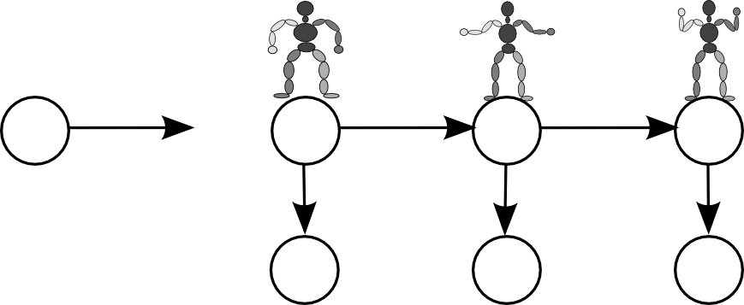
Enter hidden Markov models (HMM)
This model states that we only observe the images directly and the states indirectly – they are hidden (latent variables). If states are discrete we have a HMM.
First order Markov chain in the states.
Notes:
Lets extend the model with observations

Slide 37
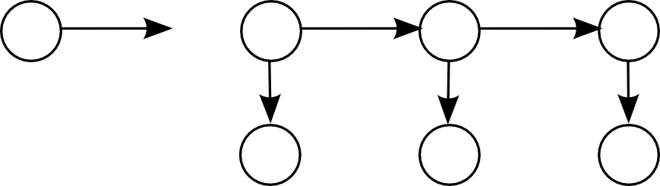
We need a probabilistic observation model
How about a Gaussian observation model?
Or perhaps more useful

Slide 38
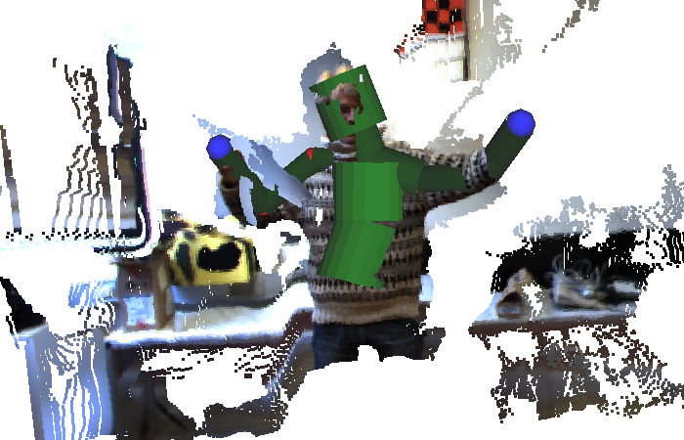
Observations in practice
compares the image (here a stereo depth map) and state

Slide 39
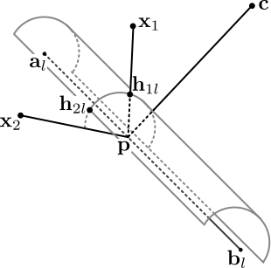
Observational model using stereo video
Observations are collections of 3D stereo points:
Introduce simple skin model: A capsule per bone.
Observational model:
Notes:
Concrete example of H:
Capsule = cylinder capped by hemispheres
Assume independence of stereo points and measure distance to capsule surface.
Shortest distance to skin and robust to outliers.

Slide 40
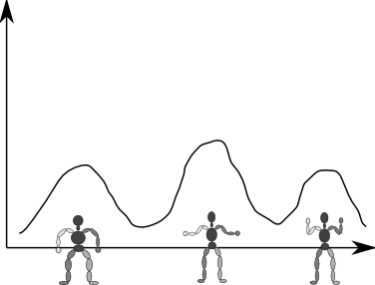
How to do tracking (estimation of pose)?
If we want to do real-time tracking we need
And then take averages to compute a prediction of the current state.
The model gives us the joint distribution
Probability of state given video sequence
Notes:
Joint distribution – this is just an application of the product rule

Slide 41
Probability theory crash course
by applying the sum and product rules we have
and Hence what we need can be derived from the joint distribution.

Slide 42
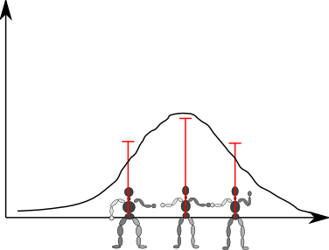
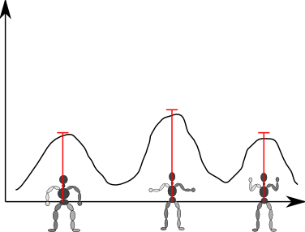
So we need to sequentially estimate (Details covered in Advanced topics in data modeling)
Kalman filtering
Particle filtering
Assume Gaussianity and linearity of observations and states.
Estimate mean state and covariance.
Particles: A state and a weight:

Slide 43
Voila! We now have a visual tracker
Notes:
Anvender I størrelsesordnen 100 partikler

Slide 44
And here is another sequence showing different inference methods
Notes:
NOTICE how the amount of particles has a huge impact on the tracking quality.

Slide 45
Per frame part-based recognition of pose (A model-free approach)
Shotton et al.: CVPR 2011
Notes:
This is the methods used by Microsoft in their X-Box 360 and MS Windows kinect tracker:
For each depth pixel predict which part it belongs to (pixel classification (random forest of decision trees) / part distribution estimation – color is the most likely part) Based on this part distribution predict joint 3D locations (for each part corresponding to a joint perform a local search for the mode of the part distribution using MeanShift)
This method requires a lot of training data (millions of examples of different body sizes and poses)

Slide 46
Summary
Visual tracking of 3D human motion:
Marker-based
Marker-less
Marker-less tracking:
Model-based (what we saw in detail)
Model-free
Model-based tracking requires:
Human body model
Relation between model and observations
Tracking is sequential filtering of the predicted pose (too avoid jitter in the estimated pose).

Slide 47
Literature
Reading material:
R. Poppe: Vision-based human motion analysis: An overview. Computer Vision and Image Understanding, 108 (1-2): 4-18, 2007.
Additional material:
J. Shotton et al: Real-Time Human Pose Recognition in Parts from Single Depth Images. Proceedings of CVPR, 1297-1304, 2011.
S. Hauberg and K. Steenstrup Pedersen: Predicting Articulated Human Motion from Spatial Processes. International Journal of Computer Vision, 94(3): 317-334, 2011.
R. Poppe: A survey on vision-based human action recognition. Image and Vision Computing, 28(6): 976-990, 2010.
Notes:
Additional material: I recommend this paper – it’s a classic and many filtering methods are based on this.

Slide 48
Remember to fill in the students course evaluation

